Slide 1
UNIT-IV
Mobile Eco System, Platforms, Application Frameworks

Slide 2
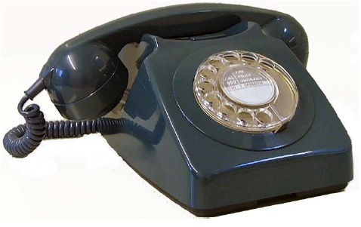
The traditional telephone

Slide 3
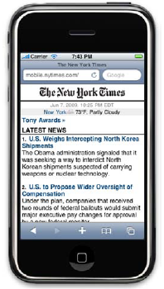
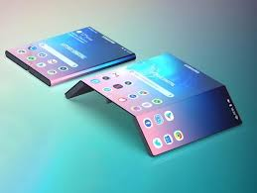
A modern mobile phone

Slide 4
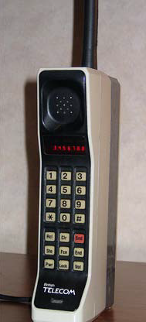

Brick Era (1973–1988)
The Motorola DynaTAC 8000X was the first mobile phone to receive FCC acceptance,
in 1983; DynaTAC was actually an abbreviation of Dynamic Adaptive Total Area Coverage

Slide 5
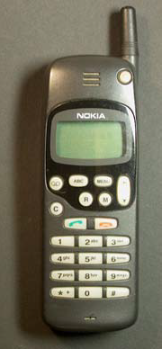
Candy Bar Era (1988–1998),
The network shifted to second-generation (2G) technology, starting in Finland in 1991.

Slide 6
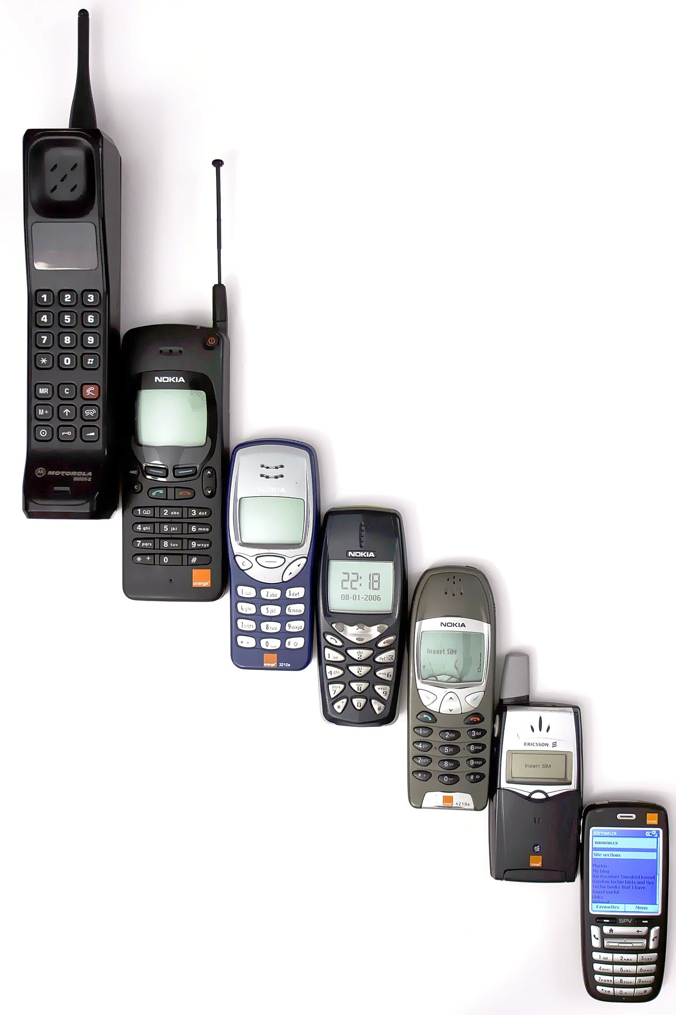

Slide 7
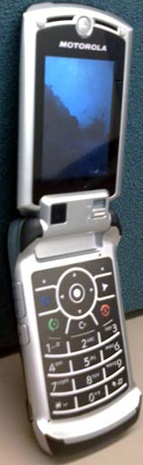
Feature Phone Era (1998–2008),
services on the phone, like listening to music and taking photos, and introduced the use of the Internet on a phone.
The Motorola RAZR, probably the most iconic device from the Feature Phone Era

Slide 8
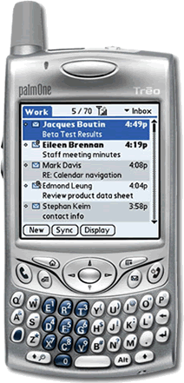
The Smartphone Era (2002 to the present)
Use a common operating system, a larger screen size, a QWERTY keyboard or stylus for input, and Wi-Fi or another form of high-speed wireless connectivity

Slide 9
Symbian OS
Symbian—initially a joint venture of mobile device makers Nokia, Motorola, Ericsson, and Psion, and now fully owned by Nokia—created the Symbian OS, a smartphone operating system containing common libraries, tools, and frameworks.
The Symbian OS is used for a variety of mobile devices, the most recognizable of which are the Nokia S60.
Nokia defined the devices of the Smartphone Era.

Slide 10
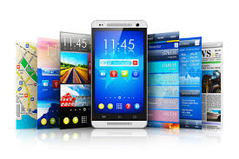
The Touch Era

Slide 11
iPhone
January 9, 2007, Steve Jobs introduced the world to the iPhone.
iPhone 3G - bestselling mobile device
Surpassed the long-established Motorola RAZR.

Slide 12
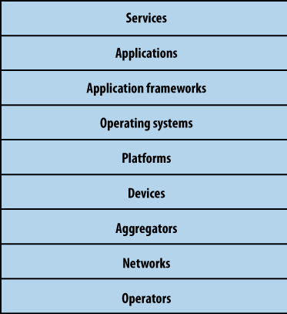
The Mobile Ecosystem

Slide 13
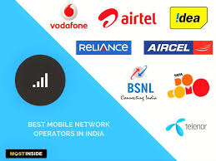
Operators
Mobile Network Operators (MNOs); mobile service providers, wireless carriers, or simply carriers; mobile phone operators; or cellular companies.
They install cellular towers, operate the cellular network, make services (such as the Internet) available for mobile subscribers.
and they often maintain relationships with the subscribers, handling billing and support, and offering subsidized device sales and a network of retail stores.

Slide 14
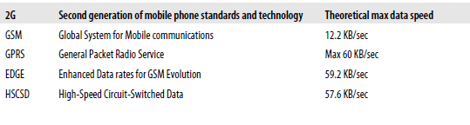
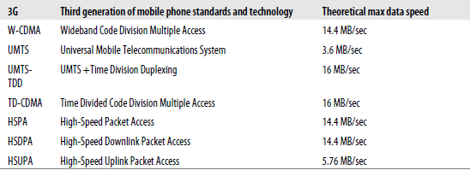
Networks
Operators operate wireless networks

Slide 15
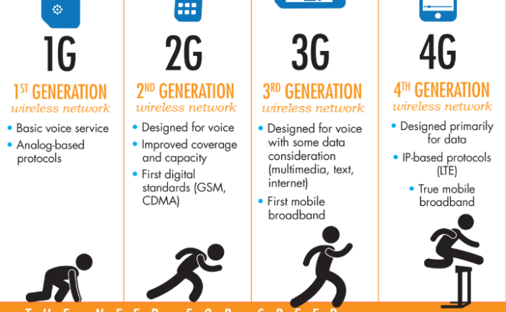
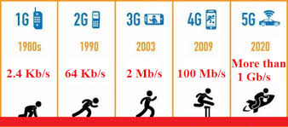

Slide 16
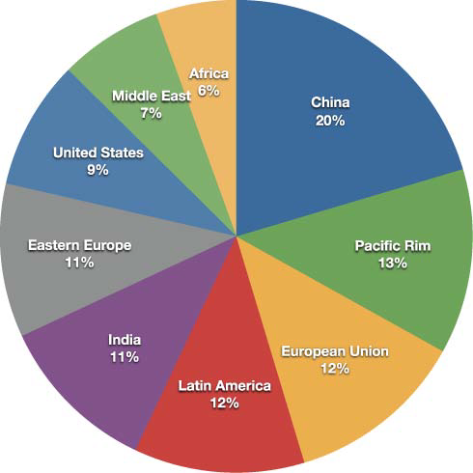
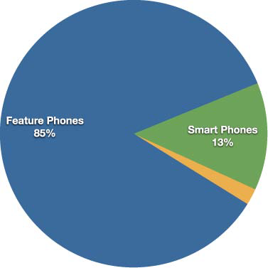
Devices
handsets or terminals

Slide 17
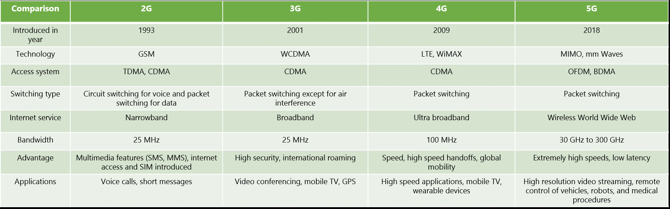
Comparision 2G,3G,4G,5G

Slide 18
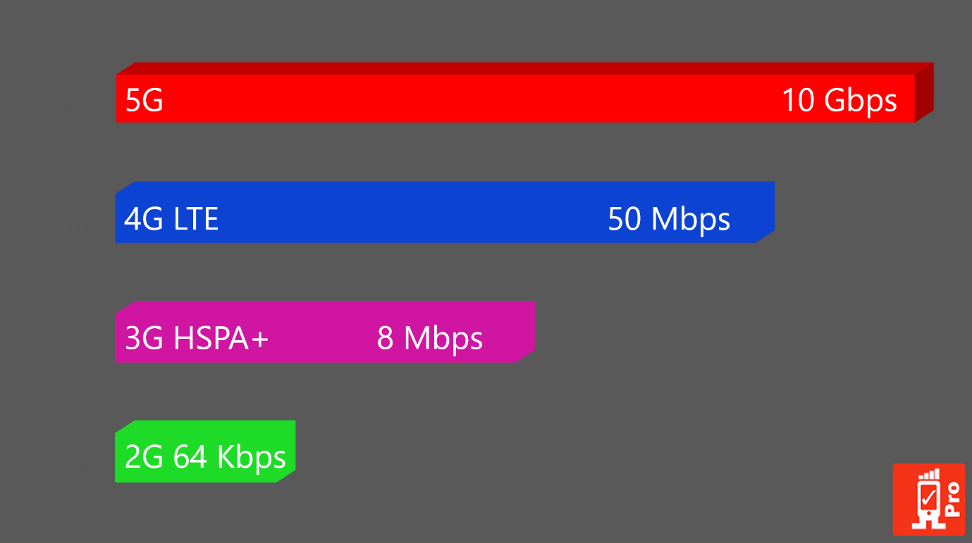
Comparision 2G,3G,4G,5G

Slide 19
Platforms
To provide access to the devices, sold to device makers.
split into three categories: licensed, proprietary, and open source
Java Micro Edition (Java ME)
  Formerly known as J2ME, Java ME is by far the most predominant software platform of any kind in the mobile ecosystem.
Binary Runtime Environment for Wireless (BREW)
  BREW is a licensed platform created by Qualcomm for mobile devices
Windows Mobile
  Windows Mobile is a licensable and compact version of the Windows operating system
LiMo
  LiMo is a Linux-based mobile platform created by the LiMo Foundation.

Slide 20
Proprietary
designed and developed by device makers for use on their devices.
Palm
  Palm uses three different proprietary platforms
BlackBerry
  Research in Motion maintains their own proprietary Java-based platform, used exclusively by their BlackBerry devices.
iPhone
  Apple uses a proprietary version of Mac OS X as a platform

Slide 21
Open Source
Open source platforms are mobile platforms that are freely available for users to download, alter, and edit.

Slide 22
Operating Systems
Operating systems often have core services or toolkits that enable applications to talk to each other and share data or services.
Symbian
Windows Mobile
Palm OS
Linux
Mac OS X
Android

Slide 23
Application Frameworks
Application frameworks often run on top of operating systems, sharing core services
such as communications, messaging, graphics, location, security, authentication, and many others
Java.
S60
BREW
Flash Lite
Cocoa Touch
Android SDK
Web Runtimes (WRTs)
WebKit

Slide 24
Applications
Application frameworks are used to create applications, such as a game, a web browser, a camera, or media player.

Slide 25
Services
Services include tasks such as accessing the Internet, sending a text message, or being able to get a location—basically, anything the user is trying to do.

